Slide 1

Gömülü Sistemler 2022 Güz
Lab. 0: Raspberry Pi ile Temel Konfigürasyon
Arş. Gör. Burak Ahmet ÖZDEN bozden@yildiz.edu.tr

Slide 2

Terminal ekranı
rasbian işletim sistemini yüklediğiniz SD kartınızı Raspberry Pi cihazınıza takıp daha sonra Raspberry Pi cihazınızı HDMI kablosuyla monitöre bağladığınız zaman karşınıza bu ekran gelmektedir.

Slide 4
Terminal ekranında bu komutlar kullanılacak
cat [name] | Show the contents of the file [name]
cd .. | Change to parent directory
cd [path] | Move to the directory at [path]
cd / | Change to root directory
cd ~ | Change to your home directory - usually "/home/"
chmod [who][+,-,=][permissions] [name] | Change the permissions for a file
chmod 777 [name] | Allow all users to read, write and execute the file [name]
chmod u+x [name] | Allow the user to execute [name]
cp -r [from] [to] | Copy all files and subdirectories from source [from] to destination [to]
cp [from] [to] | Copy a file from source [from] to destination [to]
find | Search for files and their contents
grep ‘string’ [name] | Search inside one or more files for occurrences of ‘string’
head [name] | Return all occurrences of 'string' within file [name]
ls | List the contents of the current directory
ls -a | List all files including hidden files
ls -l | List the contents of the current directory with more file information
ls [path] | List the contents of the directory found at [path]
man [command] | Open the manual/help page for [command]
man man | Open the manual/help page for the ‘man’ command (helpception)
mkdir [name] | Create a directory called [name] in the current working directory
mv -r [from] [to] | Move all files and directories from source [from] to destination [to]
mv [from] [to] | Move a file from source [from] to destination [to]
pwd | Show the name of the current working directory
python/python3 --version | Shows you what version of Python you currently have installed
rm -r * | Remove all files and directories from the current working directory
rm [name] | Remove the specified file
rm * | Remove all files from the current working directory
rmdir [name] | Remove the empty directory [name] from the current working directory

Slide 5
sudo [command] | Superuser do. Execute [command] with elevated privileges (Allows you to do things you usually wouldn't have access to)
sudo apt-get ​install [package] | Install a package
sudo apt-get update | Update the list of packages
sudo apt-get upgrade | Upgrade the installed packages - must be run after sudo apt-get update
sudo ​chown pi:root [name] | Change the owner of the file [name] to user 'pi' and set the group to 'root'
​sudo raspi-config | Launch the Raspberry Pi configuration menu
sudo reboot | Safely restart your Pi
sudo shutdown -h now | Safely shutdown your Pi immediately
sudo su | Places you in the root directory with root user access - be careful with this!
tail [name] | Show the end of file [name]
tar -cvzf [name] [path] | Create compressed file [name] from the contents of [path]
tar -xvzf [name] | Extract the contents of the compressed file [name]
wget [uri] | Download the file found at [uri] on the internet
nano | Open file
touch | Create file
EXTRAS
Dersin sonunda bunlarla ilgili terminal ekranında hızlıca kısa kısa örnekler yaparız.
Credit: https://www.makeuseof.com/tag/raspberry-pi-commands-cheat-sheet/

Slide 6
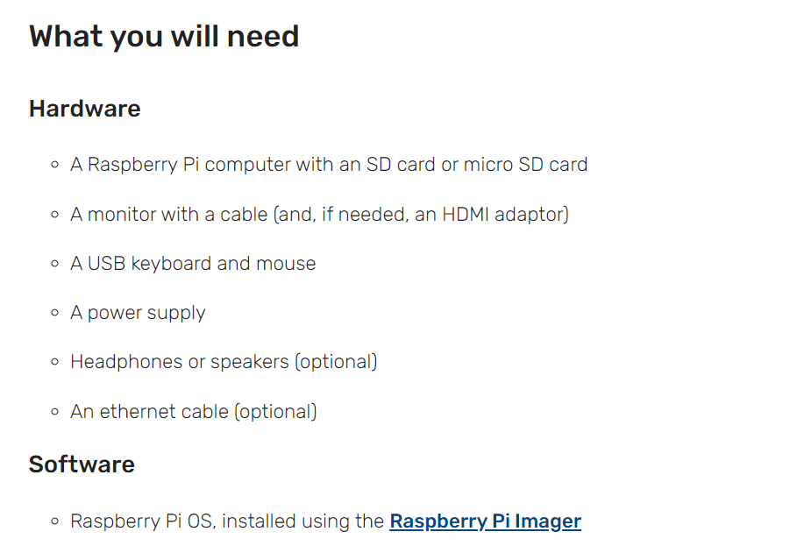

Slide 7
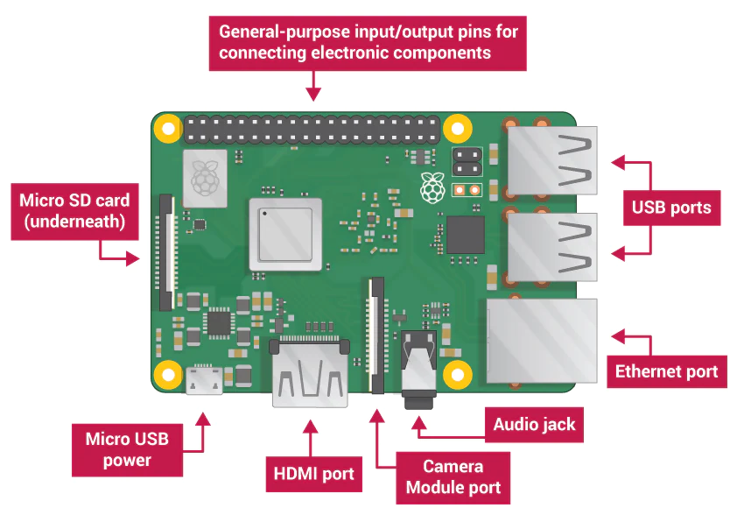
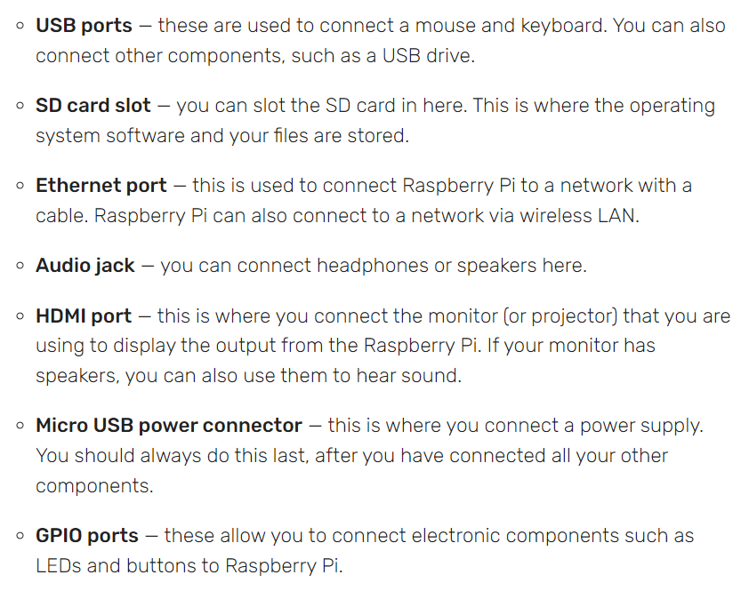
Projects | Computer coding for kids and teens | Raspberry Pi

Slide 8
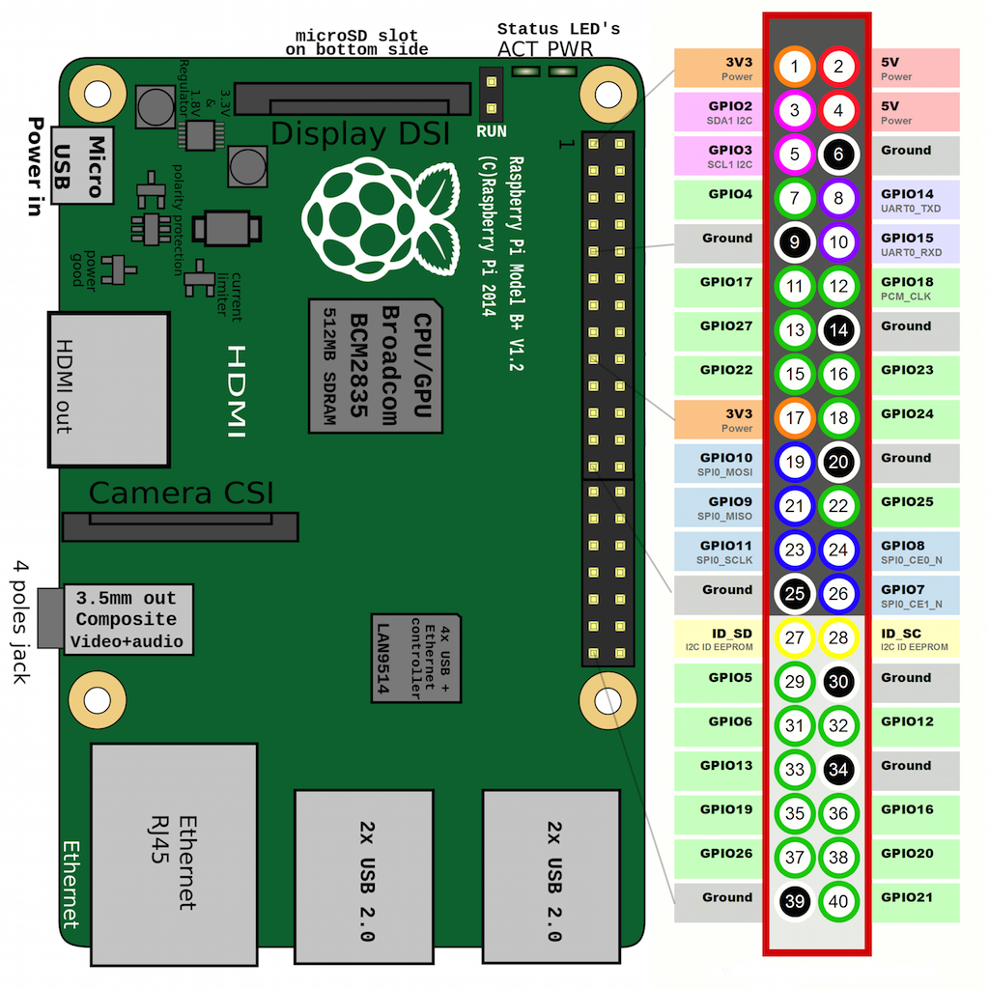
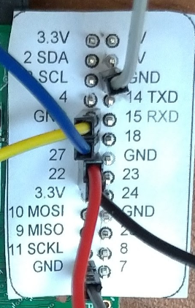
Swift 3.0 for Raspberry Pi! GPIO - Getting Started - Hackster.io

Slide 9
import RPi.GPIO as GPIO
GPIO.setmode(GPIO.BCM) # GPIO numaralarını kullanmak için BCM seçilir.
GPIO.setmode(GPIO.BOARD) # pin numaraları kullanmak için BOARD seçilir.
# bunlardan sadece biri seçebilir.
GPIO.setup( 25, GPIO.IN) # 25 numaralı GPIO pinini giriş yapıldı.
if GPIO.input(25): # if port 25 == 1
print "Port 25 is 1/GPIO.HIGH/True«
# 0; 0 volta karşılık gelir, 1 ise; 3.3 volta karşılık gelir.

Slide 10
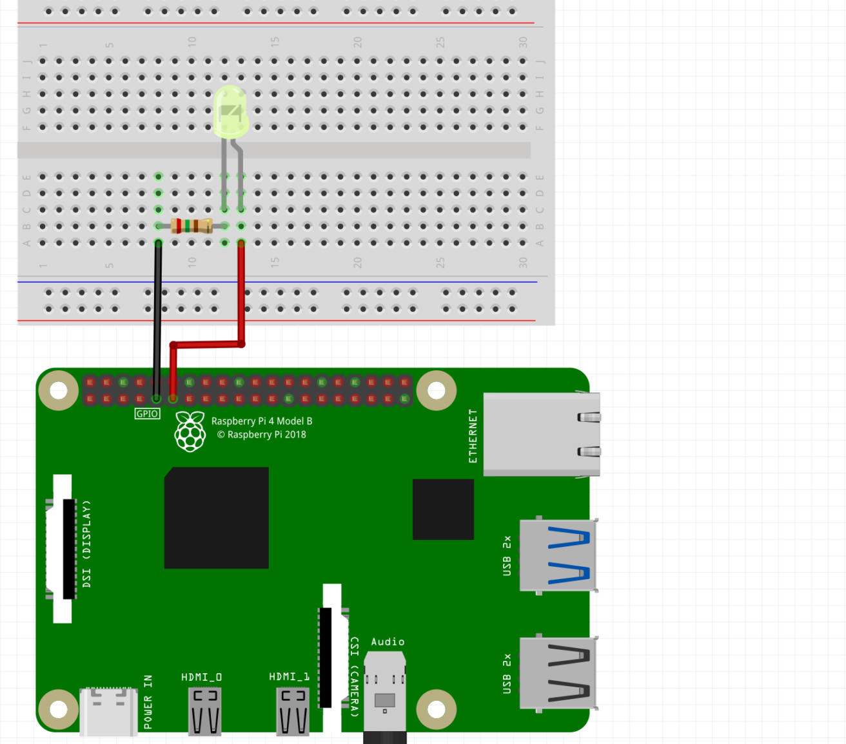
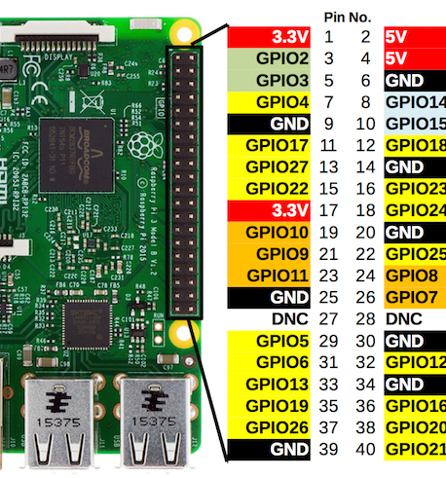
Raspberry Pi (kadakod.com)

Slide 11
import time
import RPi.GPIO as GPIO # GPIO Kütüphanesini kullan
GPIO.setmode(GPIO.BOARD) # Pin sıralamasını kullan
GPIO.setup(11, GPIO.OUT) # 11 Numaralı pini çıkış pini olarak ayarla
while True:
GPIO.output(11,True) # LED YAK
time.sleep(1) # 1 SANİYE BEKLE
GPIO.output(11,False) # LED KAPAT
time.sleep(1) # 1 SANİYE BEKLE

Slide 12
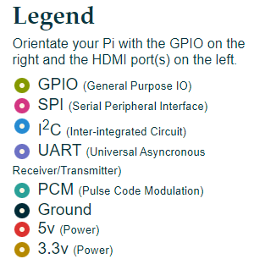
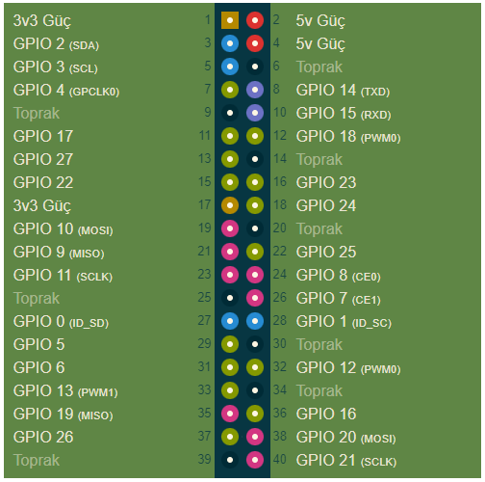
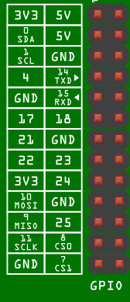
https://tr.pinout.xyz/

Slide 13
https://tr.pinout.xyz/

Slide 14
https://tr.pinout.xyz/

Slide 15
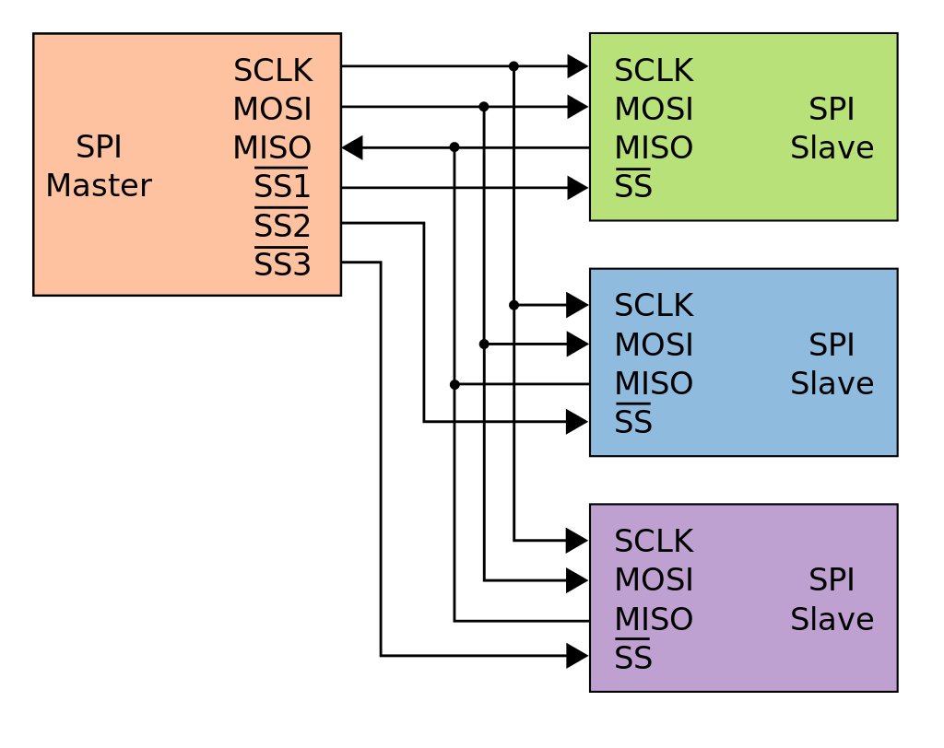
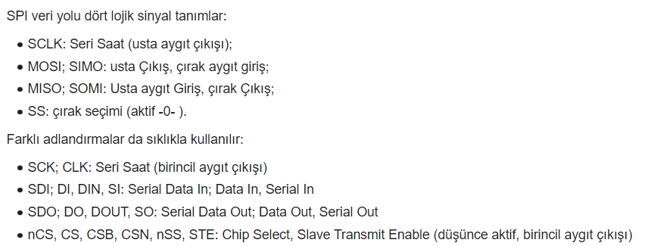
Serial Peripheral Interface
Master In, Slave Out
Master Out, Slave In
https://tr.wikipedia.org/wiki/Serial_Peripheral_Interface

Slide 16
https://tr.pinout.xyz/

Slide 17
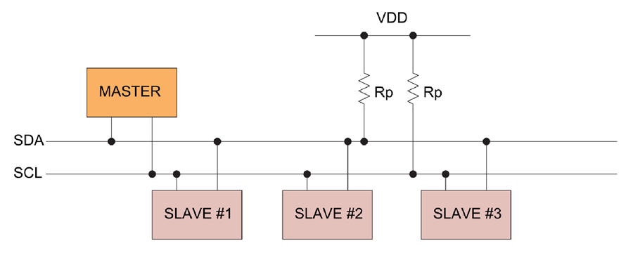
Mixed-signal and digital signal processing ICs | Analog Devices
Serial Data Line (SDA) and Serial Clock Line (SCL)

Slide 18
https://tr.pinout.xyz/

Slide 19
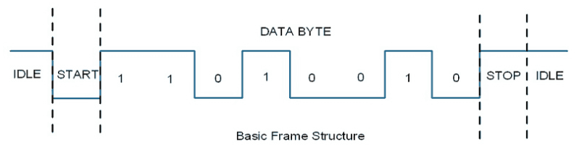
https://www.electronicwings.com/raspberry-pi/raspberry-pi-uart-communication-using-python-and-c

Slide 20
TX
RX
RX
TX
GND
GND

Slide 21
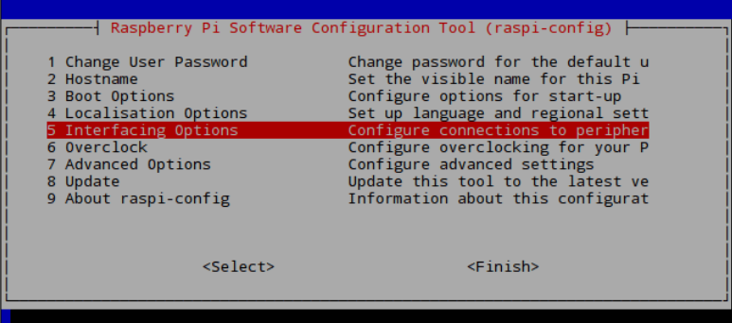
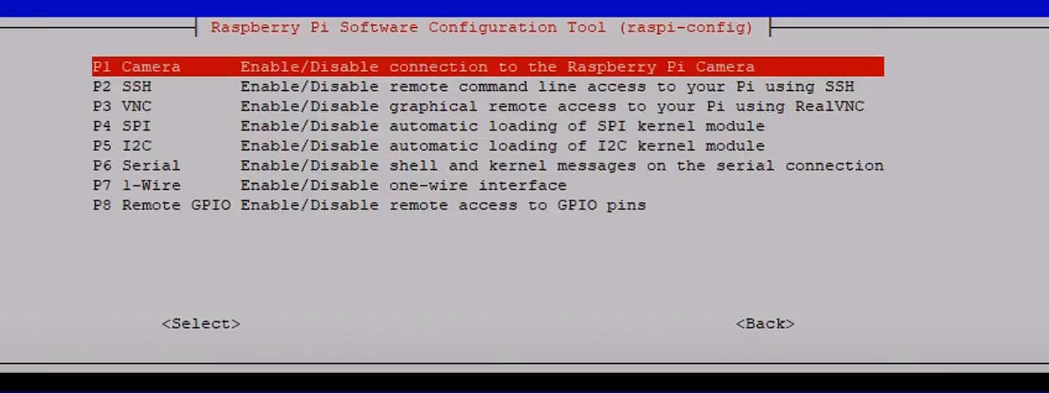
sudo raspi-config

Slide 22
https://tr.pinout.xyz/

Slide 23
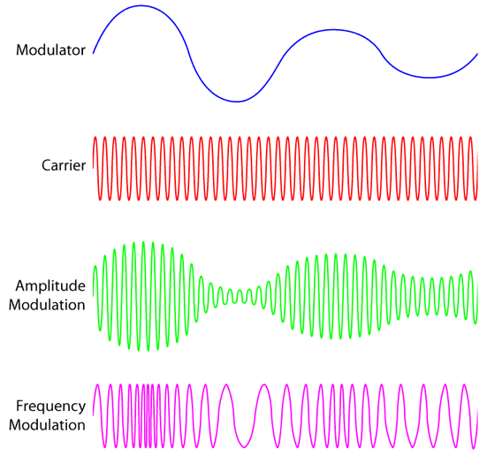

Slide 24






Kuantalama seviyesi sayısı = $ks$
Örnekleme
Bit sayısı = $n$
Kuantalama
$ks$ = $2^{n}$
Kodlama
$$ks$$
kalite
$$n$$
boyut
https://commons.wikimedia.org/

Slide 25
Analog → Digital
100 110 111 101 010 000 000 011
24 bitin iletim süresi 1ms olduğu kabul edilirse
Veri hızı = 24 kbps

Slide 26
1C
1.1Direct register access
1.2WiringPi
1.3sysfs
1.4bcm2835 library
1.5pigpio
1.6lgpio (local /dev/gpiochip I/F)
1.7rgpio (local & remote /dev/gpiochip I/F)
2C#
3Ruby
4Perl
5Python
5.1RPi.GPIO
5.2pigpio
5.3RPIO
5.4WiringPi2-Python
6Scratch
6.1Scratch using the ScratchGPIO
6.2Pridopia Scratch Rs-Pi-GPIO driver
6.3RpiScratchIO
6.3.1RpiScratchIO - Installation
6.3.2RpiScratchIO - Documentation and examples
7Java
7.1Java using the Pi4J Library
7.2Java
7.3Java Webapp GPIO web control via HTTP
Birçok farklı dilde kütüphaneler mevcuttur
8Shell
8.1sysfs, part of the raspbian operating system
8.2wiringPi - gpio utility
8.3pigpio - pigs utility
8.4pigpio - /dev/pigpio interface
8.5libgpiod - C library and tools for interacting with the linux GPIO character device
9Lazarus / Free Pascal
10BASIC
10.1BASIC - Return to BASIC
10.2BASIC
10.2.1Bywater BASIC Interpreter
10.2.1.1BASIC programming of the I/O
10.2.1.2Example of an (unstructured) BASIC program
10.3BBC BASIC
11Gambas
11.1Gambas with wiringPi
11.2Gambas with pigpio

Slide 27
RPi.GPIO
sudo apt-get install rpi-update
Normalde otomatik olarak yüklü geliyor.

Slide 28
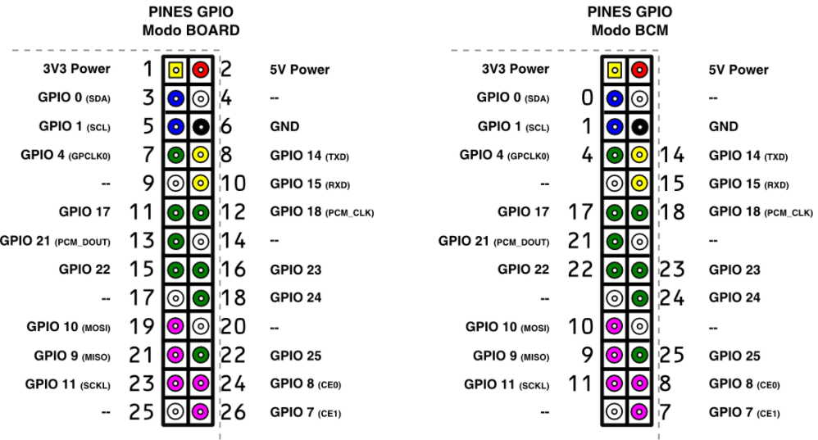
Broadcom SOC Channel

Slide 29
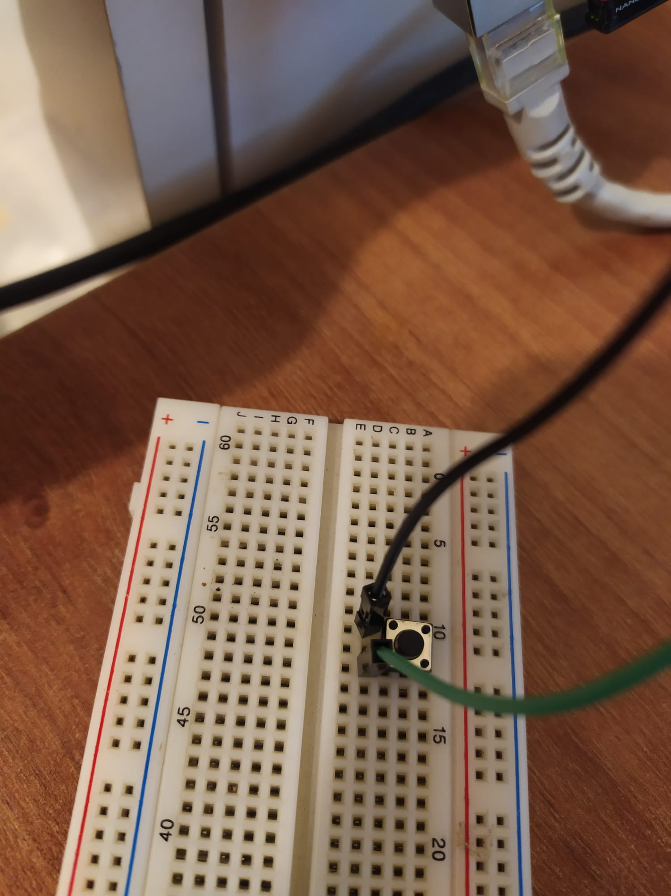
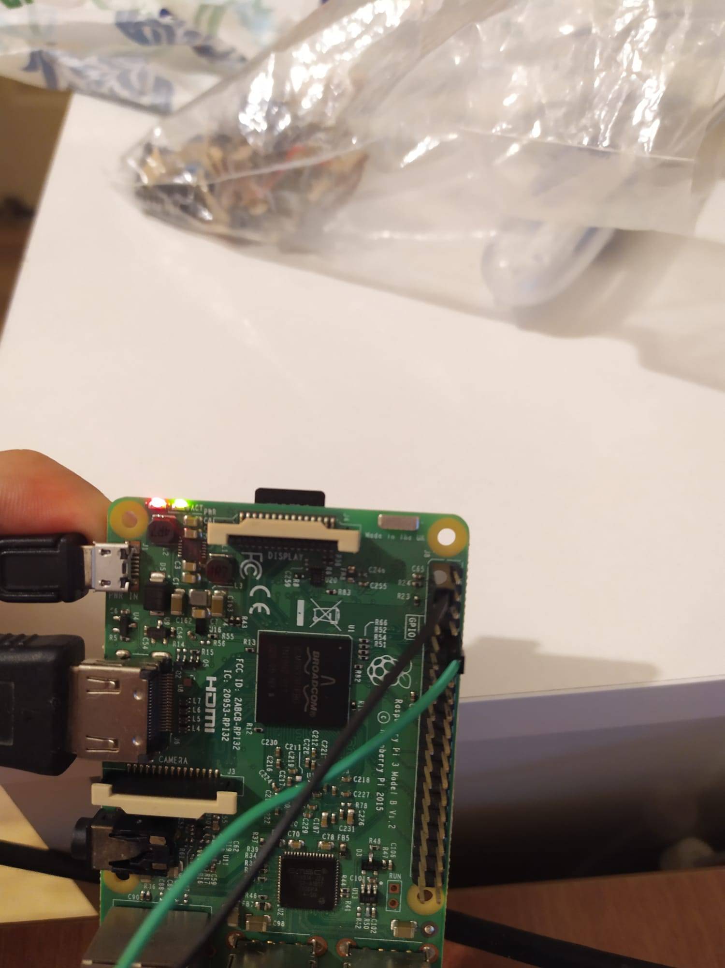

Slide 30
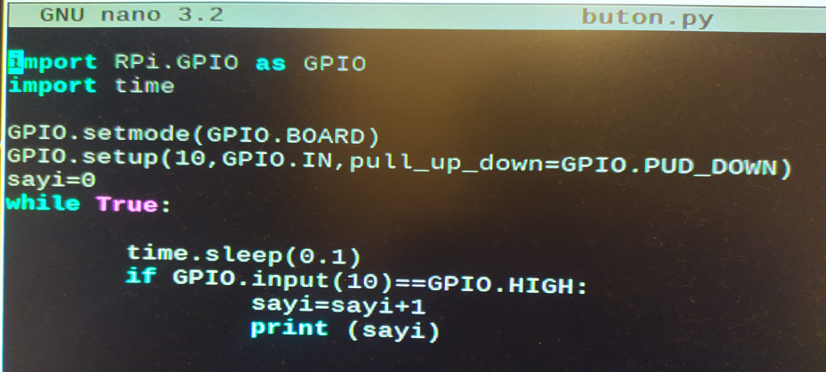
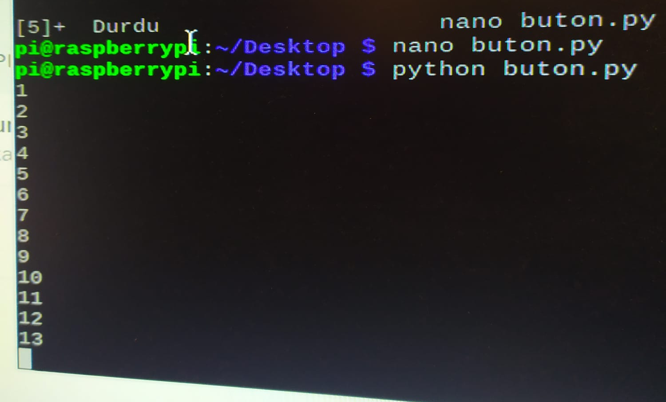



Slide 31
Teşekkürler…

